Slide 1
AWS Assosiate
Here we’ll going to learn all about AWS and their services

Slide 2
Course Fundamental and AWS Account
Here, in this section of course we’ll setup AWS account i.e [General and Production].
In both accounts, we’ll create IAM user with full administrator access.
During creating IAM user we’ll also create account of alias so that we can use that alias as a [account id].
IAM user and both accounts are MFA authenticated.
We will also create a budget according to ourselve from Cost Management.
We can create multiple AWS account with single Gmail address.
Using this trick i.e [email+(anything u can write)+ @gmail.com].
Example : [ chnoman1213+aws1@gmail.com ].

Slide 3
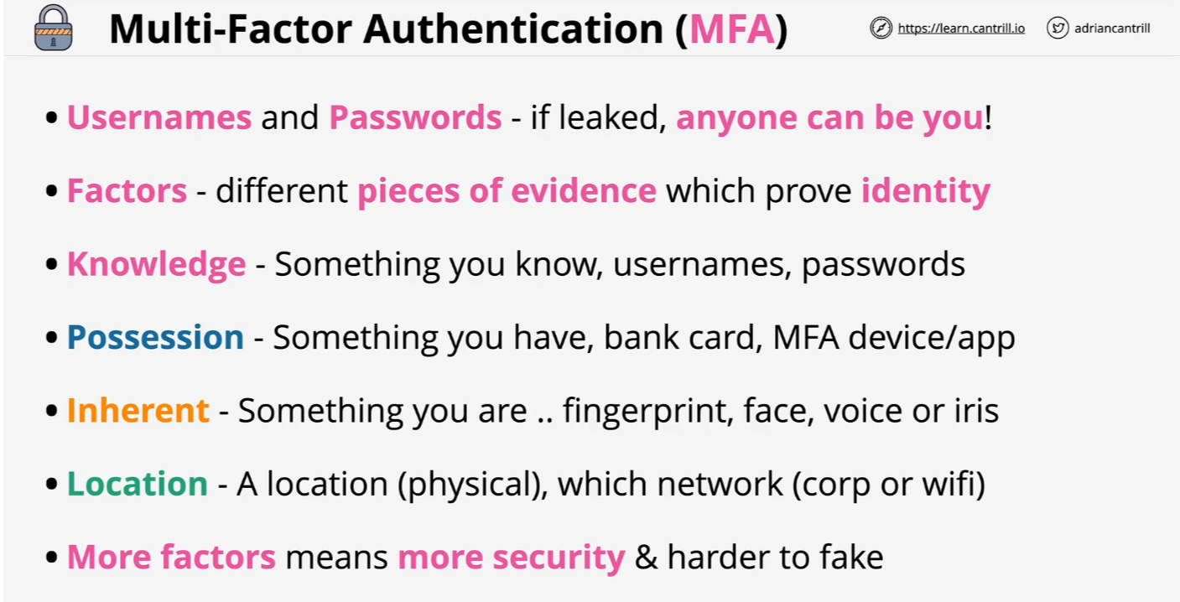
MFA

Slide 4
Access Keys
Access keys can be created by using IAM user.
You can only create max 2 access for one user.
Then go to IAM user of both account and create access keys from Security and Credential section.
Keep the secret key of the access key very safe as it is like the password of the account and also that it can only be accessed at the time of creation.
To access ur IAM user account by [CLI], you’ll have to download AWS and then give these command to use.
[aws configure --profile iamadmin-production] to configure by giving public and private access keys.
[aws s3 ls --profile iamadmin-production] to test if it is configured.

Slide 5
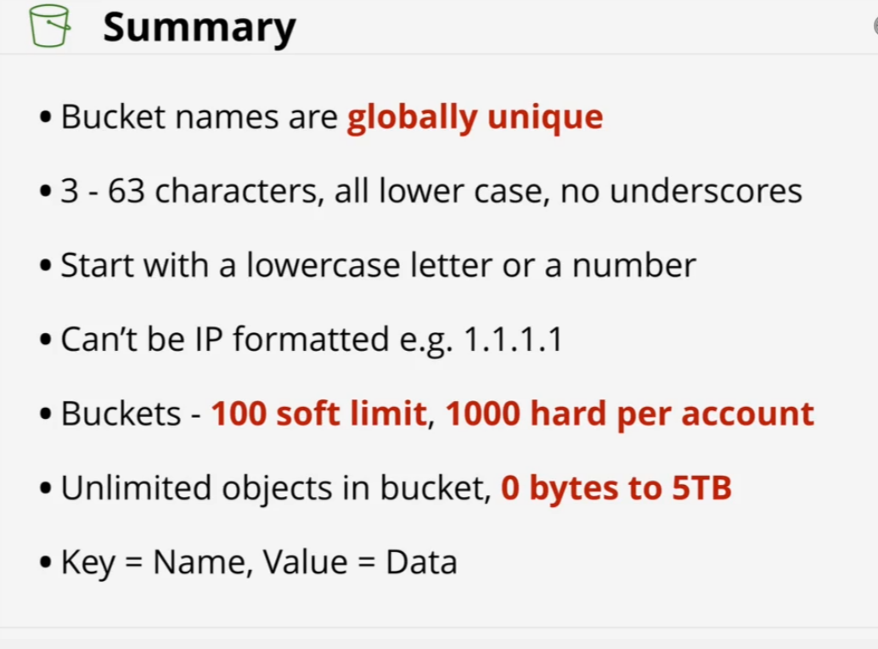
S3 Basics

Slide 6
Amazon EC2 (Elastic Compute Cloud)
Amazon EC2 (Elastic Compute Cloud) is a web service that provides resizable virtual servers (instances) in the cloud, offering flexibility to run applications with on-demand compute capacity. It supports various instance types tailored to specific workloads based on CPU, memory, storage, and networking needs (e.g., t2.micro, c5.large). EC2 enables elasticity, allowing instances to scale up or down as required. For storage, it offers persistent options with Elastic Block Store (EBS) or temporary storage with Instance Store. Networking features include assigning instances to VPCs, configuring Security Groups, and using Elastic IPs for static addressing. Pricing models include On-Demand (pay-as-you-go), Reserved Instances (discounted rates for long-term commitments), and Spot Instances (low-cost access to spare capacity). Common use cases include hosting web applications, running machine learning workloads, and setting up development or testing environments.

Slide 7
S3
Amazon S3 (Simple Storage Service) is a scalable, secure, and durable object storage service designed to store and retrieve any amount of data from anywhere. It offers unlimited storage capacity, with objects ranging from 0 bytes to 5 TB, and is built for 99.999999999% (11 nines) durability. S3 provides multiple storage classes, such as S3 Standard for frequently accessed data and S3 Glacier for archival purposes. It supports features like versioning to manage object versions, lifecycle policies for automating data transitions to cheaper storage, and encryption for securing data at rest and in transit. Common use cases include data backups, disaster recovery, hosting static websites, storing media files, and big data analytics. Permissions and access control are managed through Bucket Policies and IAM roles.

Slide 8
CloudFormation
AWS CloudFormation is an Infrastructure as Code (IaC) service that automates the deployment, management, and updating of AWS resources using templates written in JSON or YAML. It enables you to define and provision your infrastructure in a consistent, reusable manner, managing resources as a single unit called a stack. CloudFormation handles dependencies, ensures resources are created in the correct order, and supports rollback in case of deployment failures. It also allows for cross-region and multi-account deployments using StackSets. Common use cases include setting up complex architectures, automating infrastructure scaling, and creating consistent environments across projects.

Slide 9
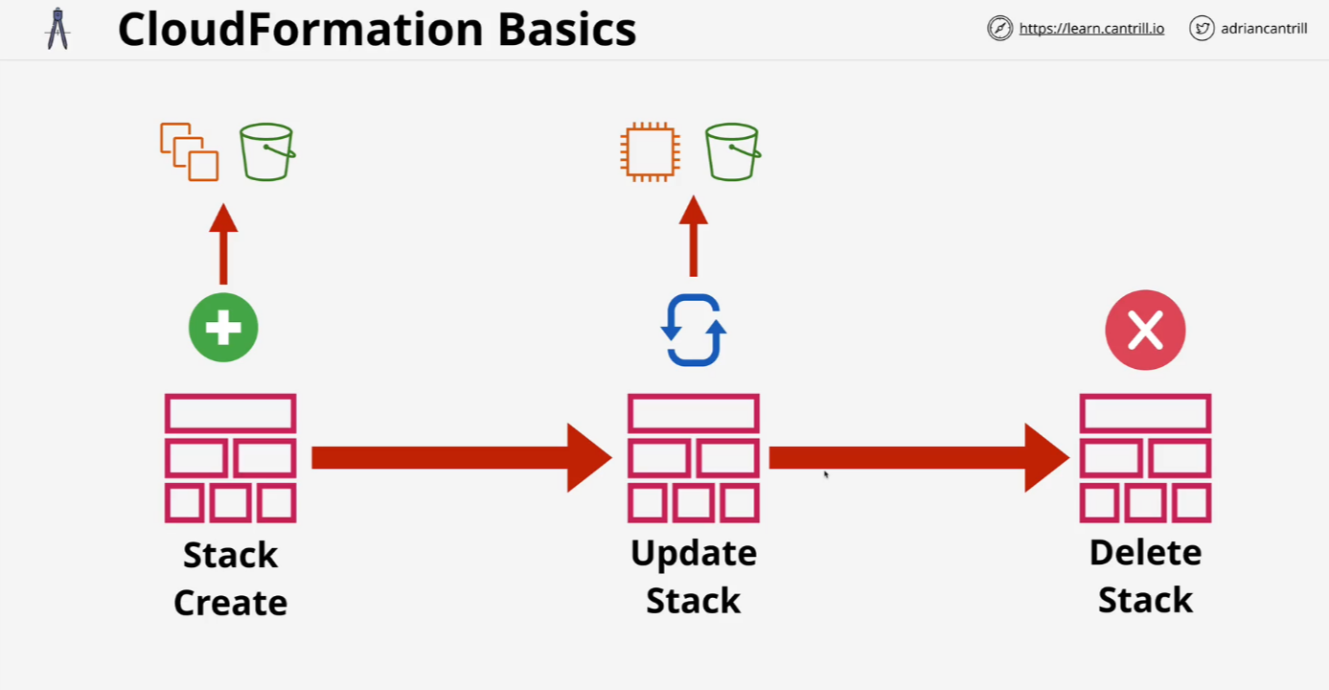
CloudFormation

Slide 10
CloudWatch
Amazon CloudWatch is a monitoring and observability service that provides real-time data and insights into AWS resources, applications, and services. It collects and tracks metrics, logs, and events, allowing you to set alarms, visualize performance through dashboards, and respond to system changes automatically. CloudWatch enables resource optimization by monitoring CPU utilization, memory usage, and application-level metrics. It also integrates with AWS services like EC2, Lambda, and RDS, as well as on-premises systems. Common use cases include performance monitoring, troubleshooting issues, logging events, and setting up automated actions based on predefined thresholds.

Slide 11
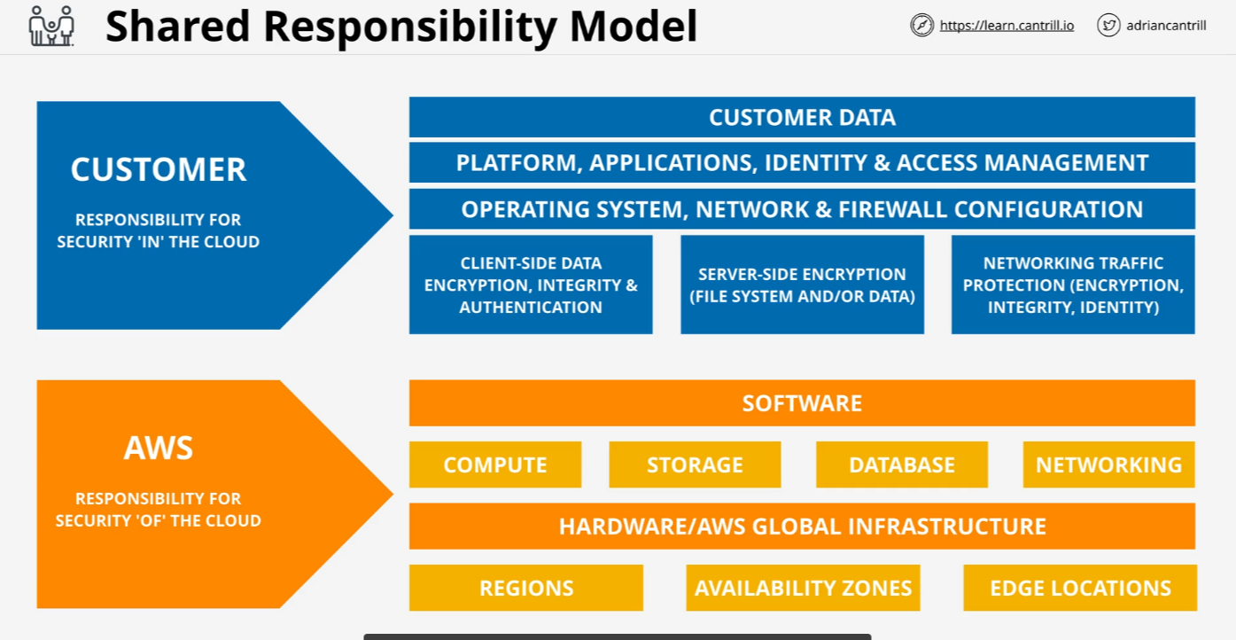
Shared Responsibility Model

Slide 12
High-Availability vs Fault-Tolerance vs Disaster Recovery
High Availability (HA) ensures that a system remains operational with minimal downtime by using redundancy and failover mechanisms. It aims to provide continuous service, even during maintenance or hardware failures, with a typical uptime target of 99.99%. Fault Tolerance goes a step further by ensuring that a system continues functioning even when one or more components fail. It employs extensive redundancy and self-healing capabilities to prevent disruptions, making it ideal for critical applications that cannot afford any downtime. Disaster Recovery (DR), on the other hand, focuses on recovering from catastrophic failures or disasters. It involves regular backups, clear recovery procedures, and defined Recovery Time and Point Objectives (RTO and RPO) to restore systems and data after major disruptions, such as a data center failure or natural disaster. Together, these concepts ensure that systems are resilient, minimizing downtime, and enabling quick recovery from failures.

Slide 13
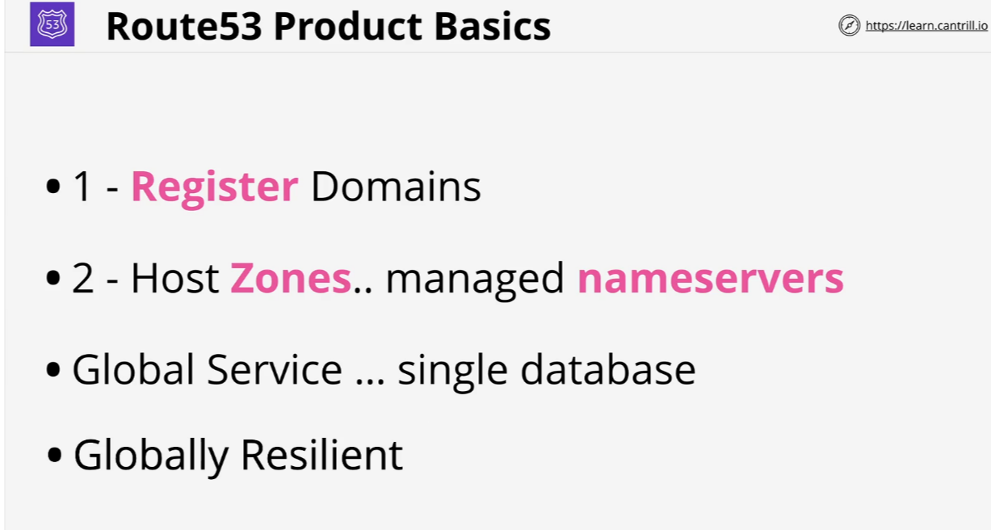
Route53 (R53) Fundamentals

